Slide 1
The Lomb-Scargle Algorithm
Alex Matheson & Austin Nhung

Slide 2
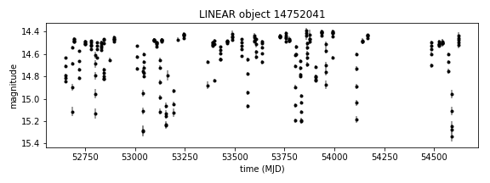
What is it?
Lomb-Scargle methods are a way to analyse signals with inconsistent time series
Generates data on underlying periodicity
FIG 1. Example data showing light intensity of a star (LINEAR catalogue number 14752041) over time. SOURCE: VanderPlas 2017

Slide 3
Where is it used?
Many applications where it is not possible to constantly record, or there are gaps in records of past events.
Sees heavy use in astonomy – weather, day/night cycle, seasonality all can prevent consistent data capture
Important in climate science – used to deal with gaps in sediment and ice cores

Slide 4
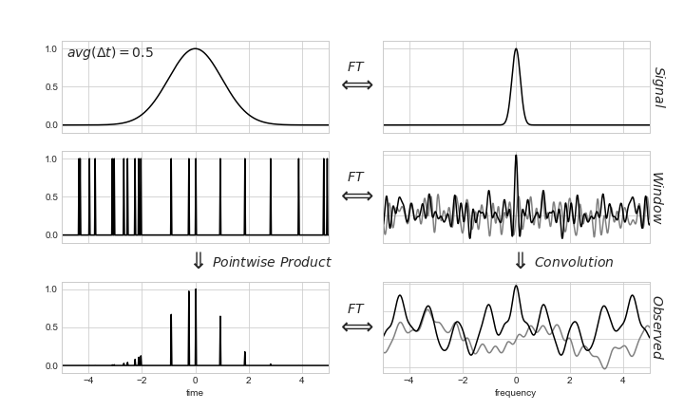
Why not FFT?
For the FFT, an uneven delta-comb sampling window is unsymmetric, and has a noisy Fourier inverse. This gives a noisy result.
Source: Vanderplas 2017

Slide 5
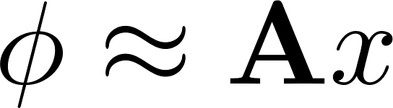
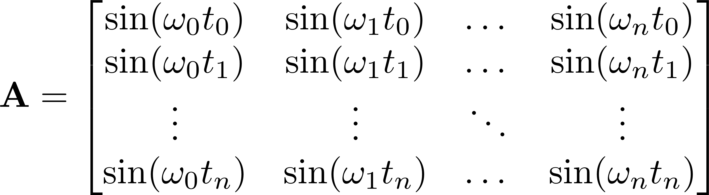
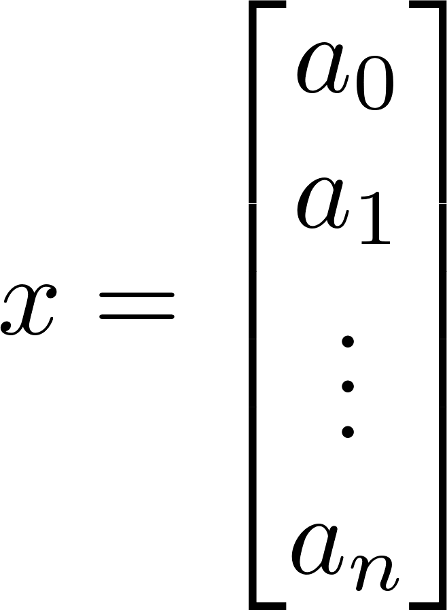
Mathematics
Relies on fourier series. Instead of fourier transforming the data straight away, it determines the frequencies of interest, then fits coefficients to the frequencies using a least-squares method.

Slide 6
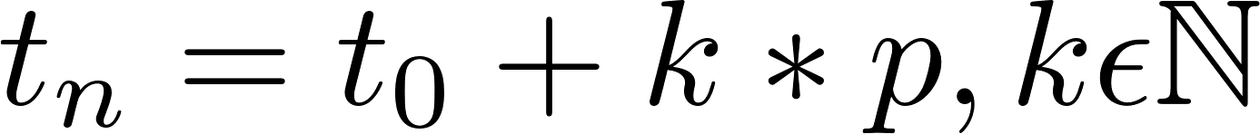
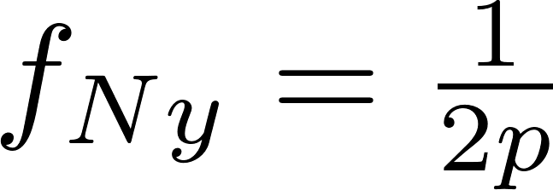
Choosing Frequencies
Different frequencies may be selected for the A matrix. A good selection of frequencies can improve results.
The minimum frequency is often set as the inverse of the test duration
The maximum frequency is often based on the Nyquist frequency.
The frequency is then oversampled for safety
The Nyquist frequency in its usual form doesn’t apply. We often use the mean or median Nyquist frequencies
Non-uniform Nyquist:

Slide 7
Astropy
Astropy has developed a simple class for handling Lomb-Scargle peridograms
Pros | Cons
Object-oriented | Automatically sets the A matrix
Simple commands | Manual selection of A values far less simple
Includes 6 different algorithm implementations | Can’t handle error in time measurements
Can handle error in signal amplitude
Built-in tests for units, significance

